Slide 1
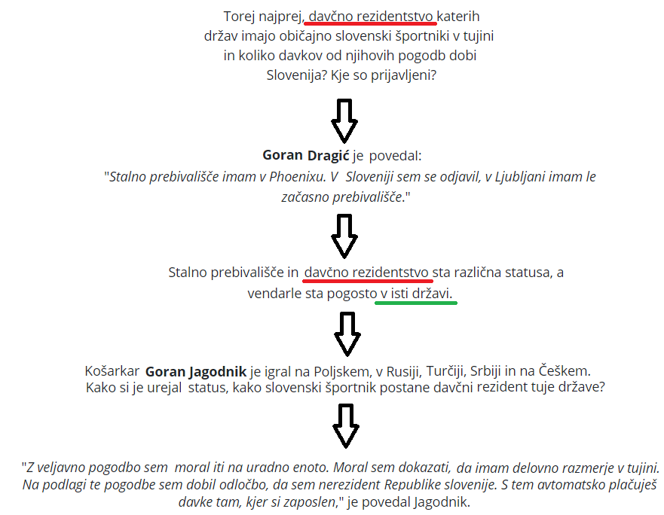

DAVKI SLOVENSKIH ŠPORTNIKOV DOMA IN V TUJINI
v
v
SPOT POLI LUKA DONČIĆ
Vir: https://www.rtvslo.si/sport/preostali-sporti/davki-slovenskih-sportnikov-doma-in-v-tujini/391224

Slide 2
