Slide 1
BRIDŽ TURNIR
DATUM:
KRAJ:
IGRAL: VAŠ PRIIMEK/PREŠEREN [1]

Slide 2
SODELUJOČI PARI S ŠIFRAMI
1. Vaš priimek-Prešeren
2. Tavčar-Cankar
3. Rebula-Finžgar
4. Gregorčič-Bevk
5. Murn-Čop
6. Jalen-Vandot
7. Jenko-Aškerc
8. Jurčič-Valvasor

Slide 3
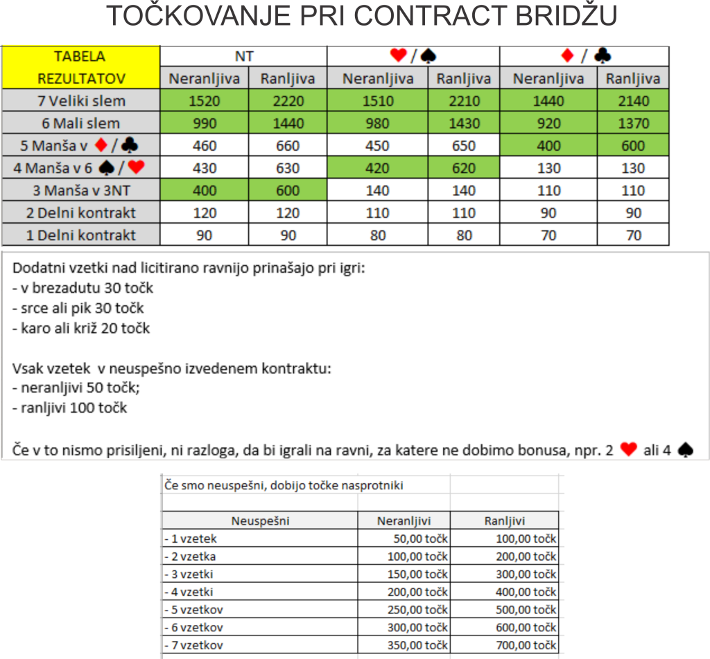

Slide 4
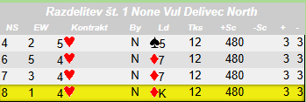
1. RAZDELITEV -> JURČIČ-VALVASOR [8] {NS}/VAŠ PRIIMEK-PREŠEREN [1]{EW}
A♠
K♠
9♠
7♠
3♠
Q♥
T♥
7♥
6♥
5♥
K♣
Q♣
5♣
A♦
N
Q♠
J♠
14
T♠
6♠
8♠
4♠
4♥ N -> /10
5♠
2♠
A♥
3♥
6
4♣
2♥
W
1
11
E
3♣
T♣
☺
2♣
9♣
K♦
6♣
Q♦
J♦
9
7♦
T♦
6♦
8♦
K♥
9♥
4♥
S
A♣
J♣
7♣
3♦
J♥
8♥
9♦
5♦
4♦
2♦
8♣
X | 1 | 2 | 3 | 4 | 5 | 6 | 7 | 8 | 9 | 10 | 11 | 12 | 13 | Štihi | Točke
N
E
S
W

Slide 5
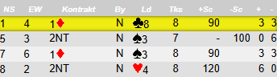
5. RAZDELITEV -> VAŠ PRIIMEK-PREŠEREN [1] {NS}/GREGORČIČ-BEVK [4] {EW}
A♠
J♠
2♠
A♥
A♣
9♣
7♣
2♣
A♦
J♦
6♦
5♠
9♦
Q♠
K♠
N
9♠
7♠
18
3♠
4♠
2NT N -> /8
Q♥
7♥
J♥
4♥
9♥
2♥
8♥
W
8
5
10
E
Q♣
K♣
☺
8♣
T♣
K♦
6♣
Q♦
7♦
T♦
4♦
4
5♦
3♦
S
2♦
T♠
8♠
6♠
K♥
T♥
6♥
5♥
3♥
J♣
3♣
8♦
5♣
4♣
X | 1 | 2 | 3 | 4 | 5 | 6 | 7 | 8 | 9 | 10 | 11 | 12 | 13 | Štihi | Točke
N
E
S
W

Slide 6
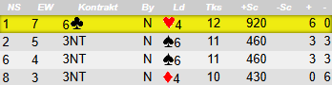
9. RAZDELITEV -> VAŠ PRIIMEK-PREŠEREN [1] {NS}/JURČIČ-VALVASOR [7] {EW}
K♠
2♠
K♥
7♥
A♣
T♣
9♣
8♣
3♣
Q♦
J♦
J♥
A♦
Q♠
J♠
7♠
N
9♠
18
8♠
5♠
T♥
6♣ N -> /12
6♠
8♥
3♠
5♥
4♥
3♥
8
9
2
T♦
2♥
W
E
J♣
K♣
☺
7♣
5♣
9♦
K♦
7♦
8♦
12
5♦
3♦
4♦
A♠
T♠
4♠
A♥
S
Q♥
9♥
6♥
6♦
2♦
Q♣
6♣
4♣
2♣
X | 1 | 2 | 3 | 4 | 5 | 6 | 7 | 8 | 9 | 10 | 11 | 12 | 13 | Štihi | Točke
N
E
S
W

Slide 7
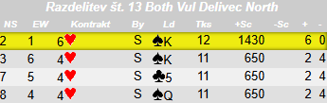
13. RAZDELITEV -> TAVČAR-CANKAR[2] {NS}/VAŠ PRIIMEK-PREŠEREN [1] {EW}
7♠
6♠
4♠
3♠
A♥
T♥
8♥
K♦
9♦
3♦
K♣
9♣
7♣
K♠
N
J♠
Q♠
10
8♠
T♠
2♠
9♠
Q♥
5♠
2♥
9♥
Q♦
6
13
5
T♦
7♥
W
E
5♥
☺
7♦
J♣
6♦
8♣
6♥ S-> /12
4♦
5♣
2♦
4♣
19
6♣
3♣
S
2♣
A♠
K♥
J♥
4♥
3♥
A♦
8♦
5♦
A♣
Q♣
6♥
J♦
T♣
X | 1 | 2 | 3 | 4 | 5 | 6 | 7 | 8 | 9 | 10 | 11 | 12 | 13 | Štihi | Točke
N
E
S
W

Slide 8
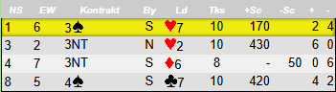
17. RAZDELITEV -> VAŠ PRIIMEK-PREŠEREN [1] {NS}/JALEN-VANDOT [6] {EW}
J♣
K♦
T♦
7♦
3♦
5♠
J♥
K♣
4♣
J♦
5♥
3♥
Q♣
A♠
N
3♠
J♠
11
2♠
T♠
T♥
3NT N -> /9
K♥
9♥
7♥
8♥
6♥
9
3
2♥
9♣
W
1
E
T♣
8♣
☺
7♣
6♣
A♦
3♣
6♦
2♣
5♦
17
9♦
4♦
8♦
K♠
Q♠
7♠
S
A♥
Q♥
4♥
A♣
5♣
Q♦
2♦
9♠
8♠
6♠
4♠
X | 1 | 2 | 3 | 4 | 5 | 6 | 7 | 8 | 9 | 10 | 11 | 12 | 13 | Štihi | Točke
N
E
S
W

Slide 9
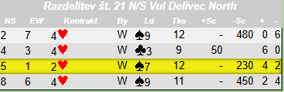
21. RAZDELITEV -> MURN-ČOP [5] {NS}/VAŠ PRIIMEK-PREŠEREN [1] {EW}
5♠
8♣
6♣
3♣
J♦
7♦
6♦
K♠
9♠
7♠
8♥
K♣
T♦
Q♠
N
A♠
3♠
☺
T♠
7
2♠
4♠
A♥
6♦
J♥
K♥
T♥
Q♥
4♥
9♥
14
4♥ W -> /10
21
12
E
2♥
W
7♥
A♣
2♣
J♣
K♦
T♣
4♦
7♣
3♦
7
4♣
2♦
S
Q♦
J♠
9♣
8♠
6♠
6♥
5♥
3♥
Q♣
5♣
A♦
9♦
8♦
5♦
X | 1 | 2 | 3 | 4 | 5 | 6 | 7 | 8 | 9 | 10 | 11 | 12 | 13 | Štihi | Točke
N
E
S
W

Slide 10
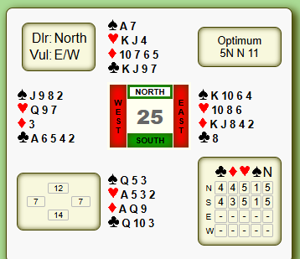
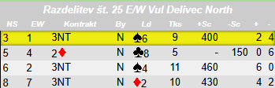
25. RAZDELITEV -> REBULA-FINŽGAR [3] {NS}/VAŠ PRIIMEK-PREŠEREN [1] {EW}
A♠
7♠
K♥
4♥
K♣
J♣
9♣
7♣
T♦
7♦
J♥
6♦
5♦
J♠
K♠
9♠
N
T♠
12
8♠
6♠
2♠
3NT N-> /9
4♠
Q♥
T♥
9♥
8♥
7♥
7
7
6♥
W
25
E
8♣
A♣
☺
6♣
K♦
5♣
J♦
4♣
8♦
2♣
4
4♦
3♦
2♦
S
Q♠
5♠
3♠
A♥
5♥
3♥
2♥
Q♣
T♣
3♣
A♦
Q♦
9♦
X | 1 | 2 | 3 | 4 | 5 | 6 | 7 | 8 | 9 | 10 | 11 | 12 | 13 | Štihi | Točke
N
E
S
W

