Slide 1


Slide 2
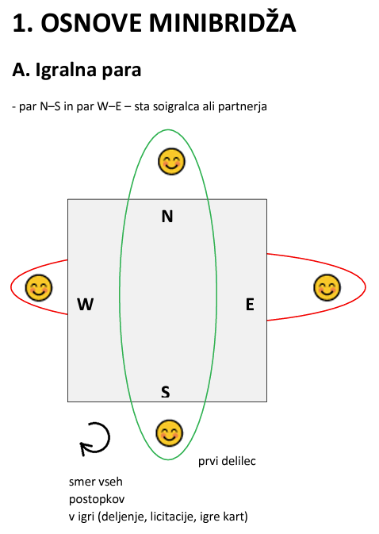

Slide 3
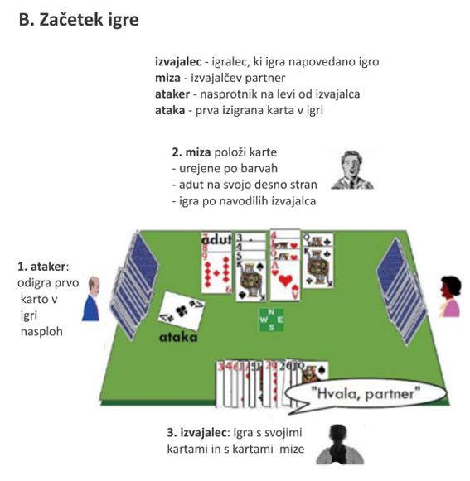

Slide 4
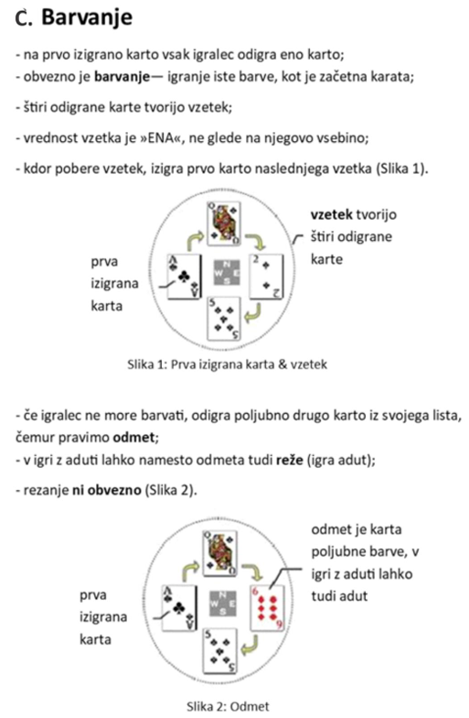

Slide 5
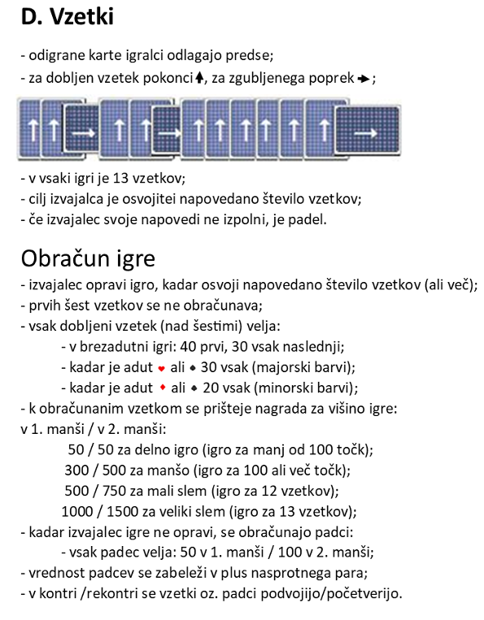

Slide 6
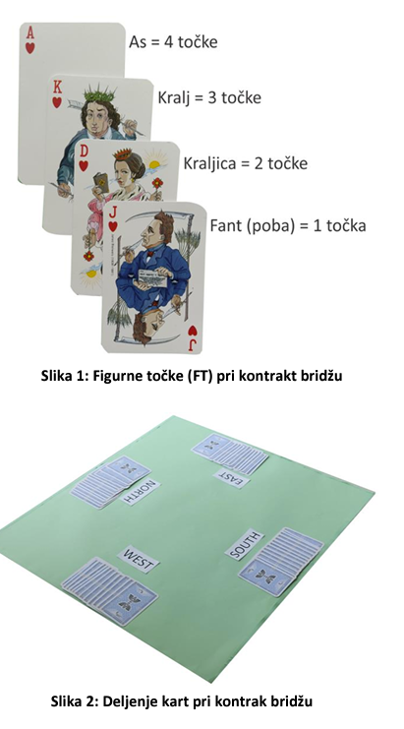

Slide 7
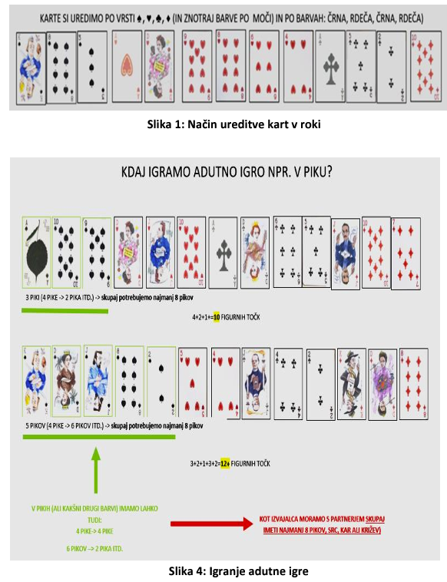
K♠ 8♠ 3♠ A♥ D♥ 9♥ 8♥ 6♥ 4♥ A♣ 5♣ 2♣ 10♦

Slide 9
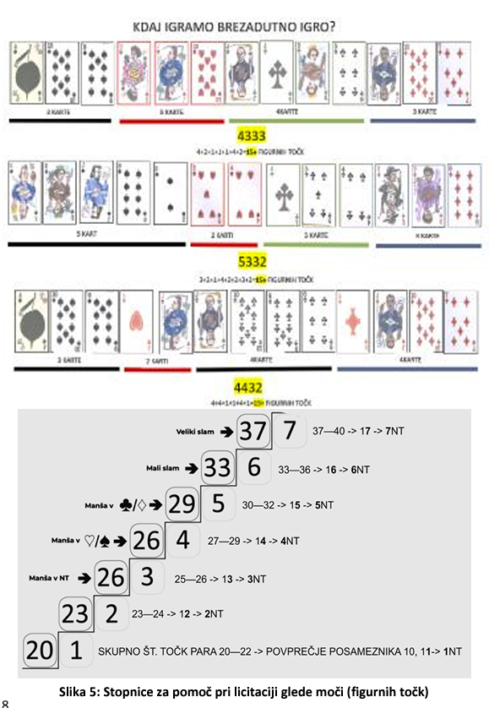

Slide 11
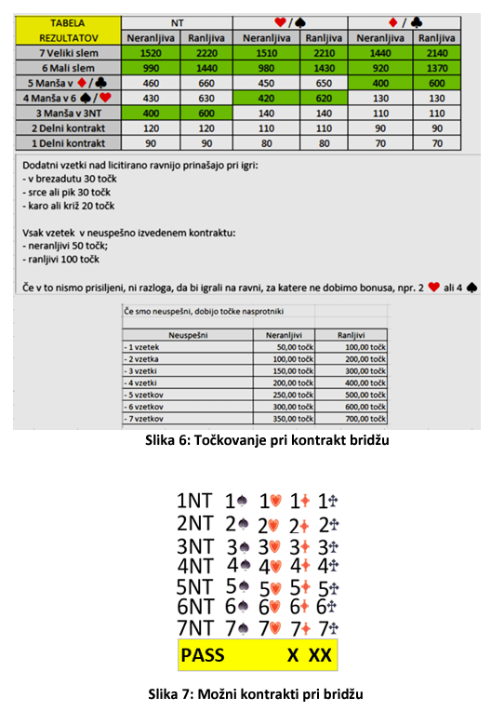
Izračun točk
https://tinyurl.com/sesgs-1
Vpis točk
https://tinyurl.com/sesgs-2

Slide 12
