Slide 1
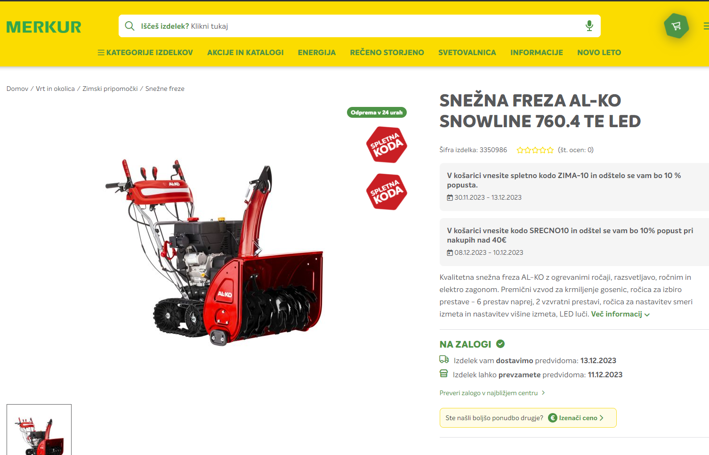
Snežna freza Al-ko snowline 760.4 TE LED navodila

Slide 2
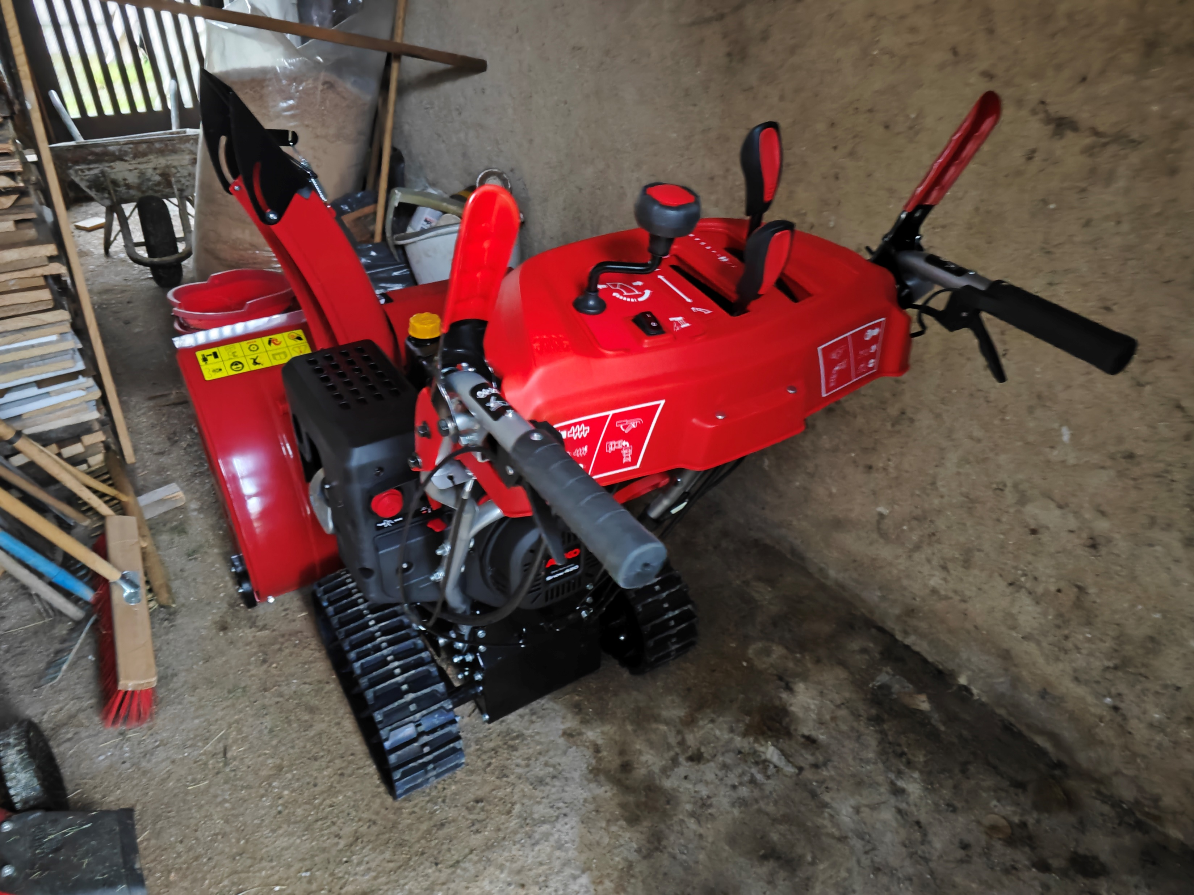

Slide 3
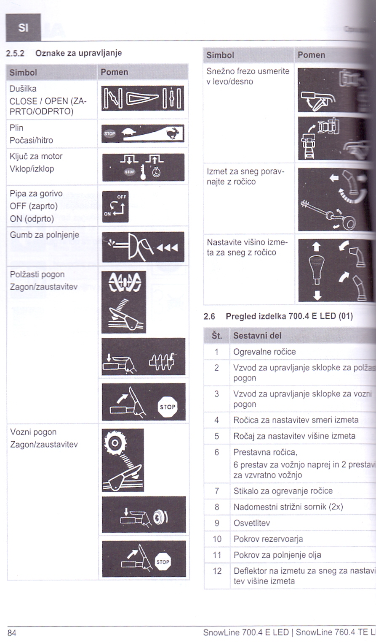
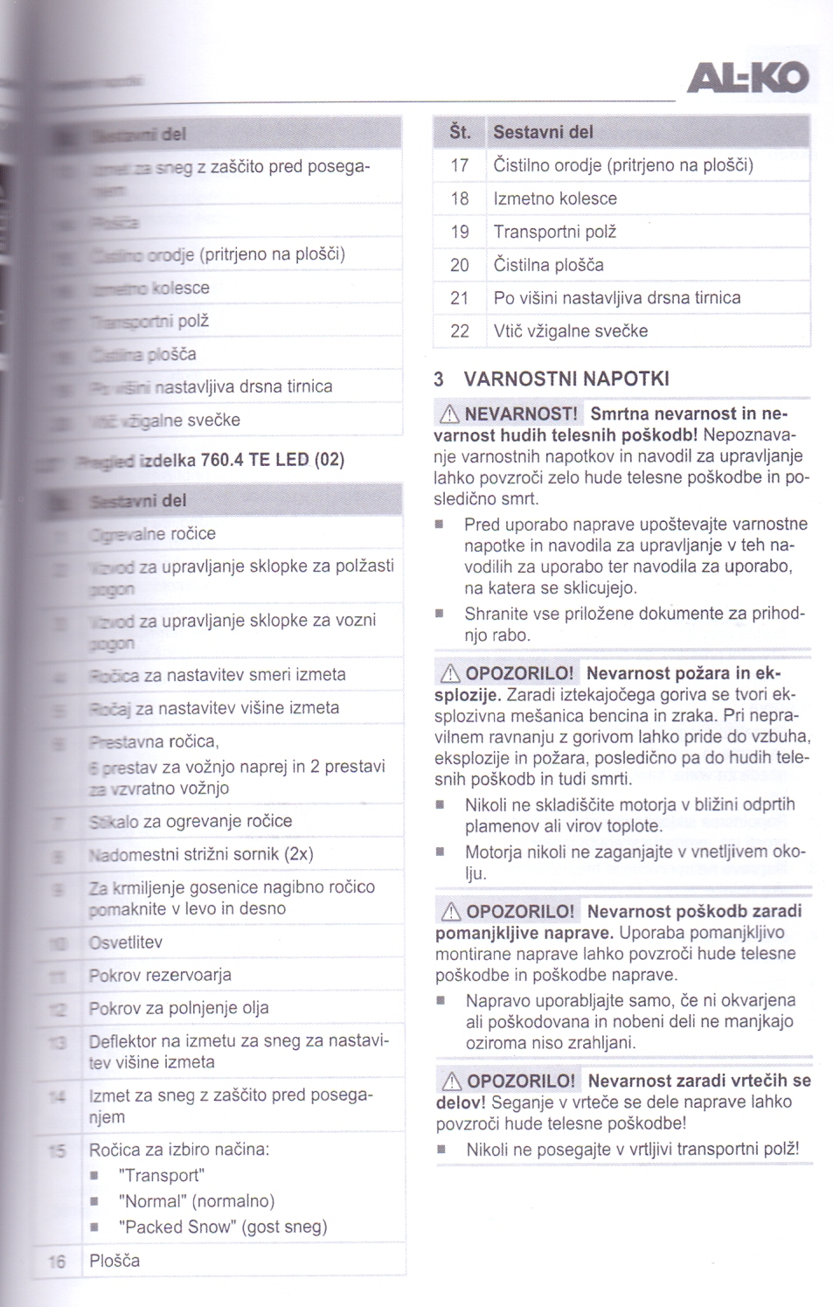
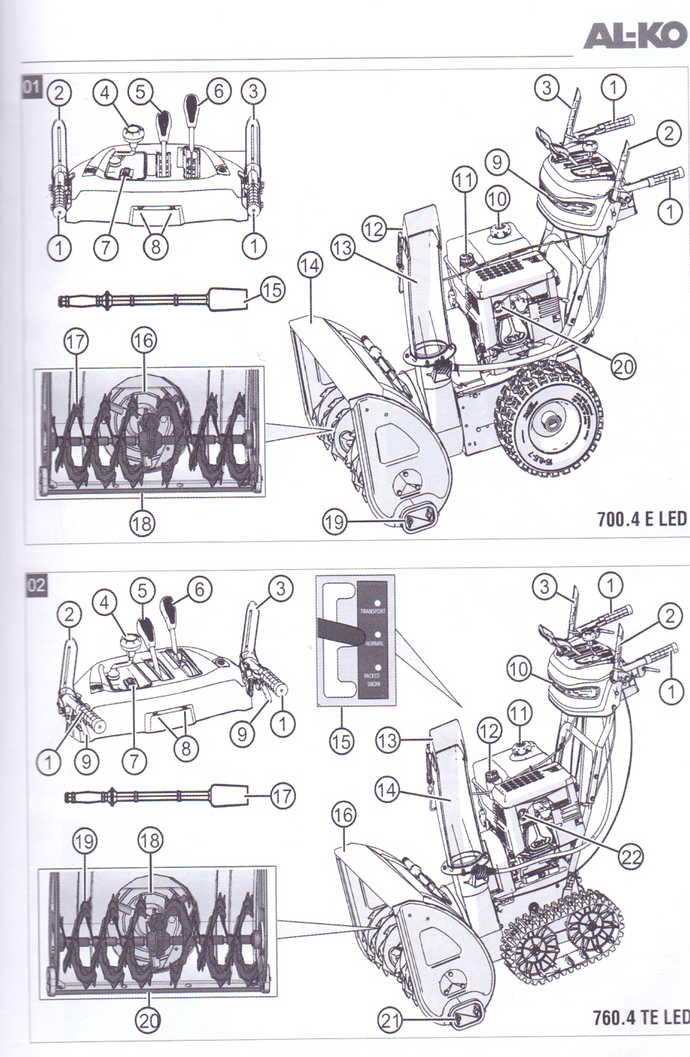

Slide 4
YOUTUBE
https://youtu.be/e8Ci1LJREOg?si=lYw11MHo-oqVPVPh
https://youtu.be/5nK_Dl8fu3c?si=28MhwKKiPoxmafr4
https://youtu.be/Zx8_JQBvnxc?si=MSzYtpbfCSNTpQgK&t=211

Slide 5
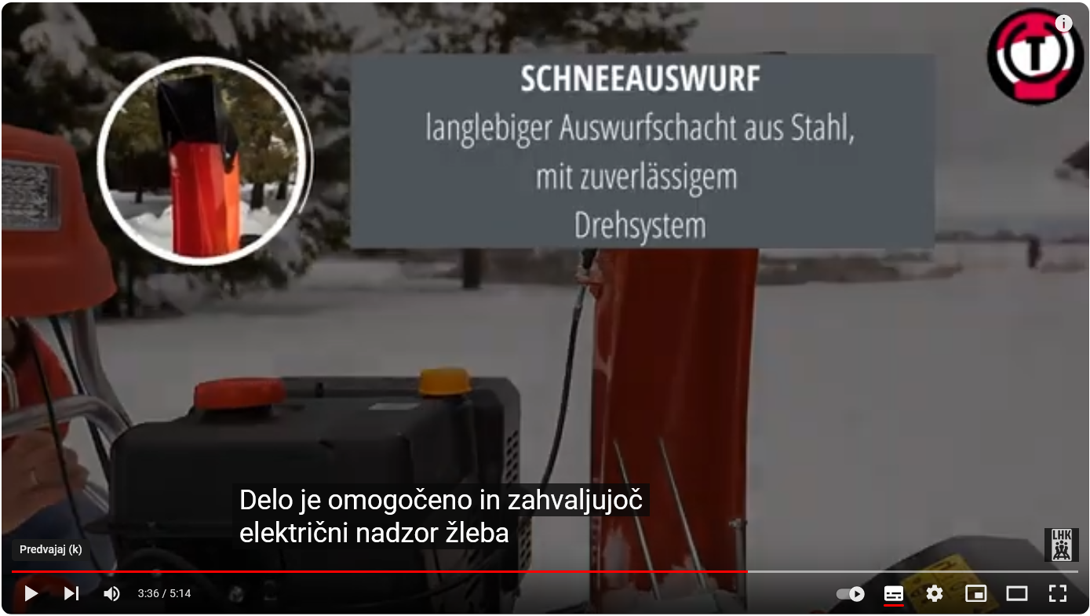

Slide 6
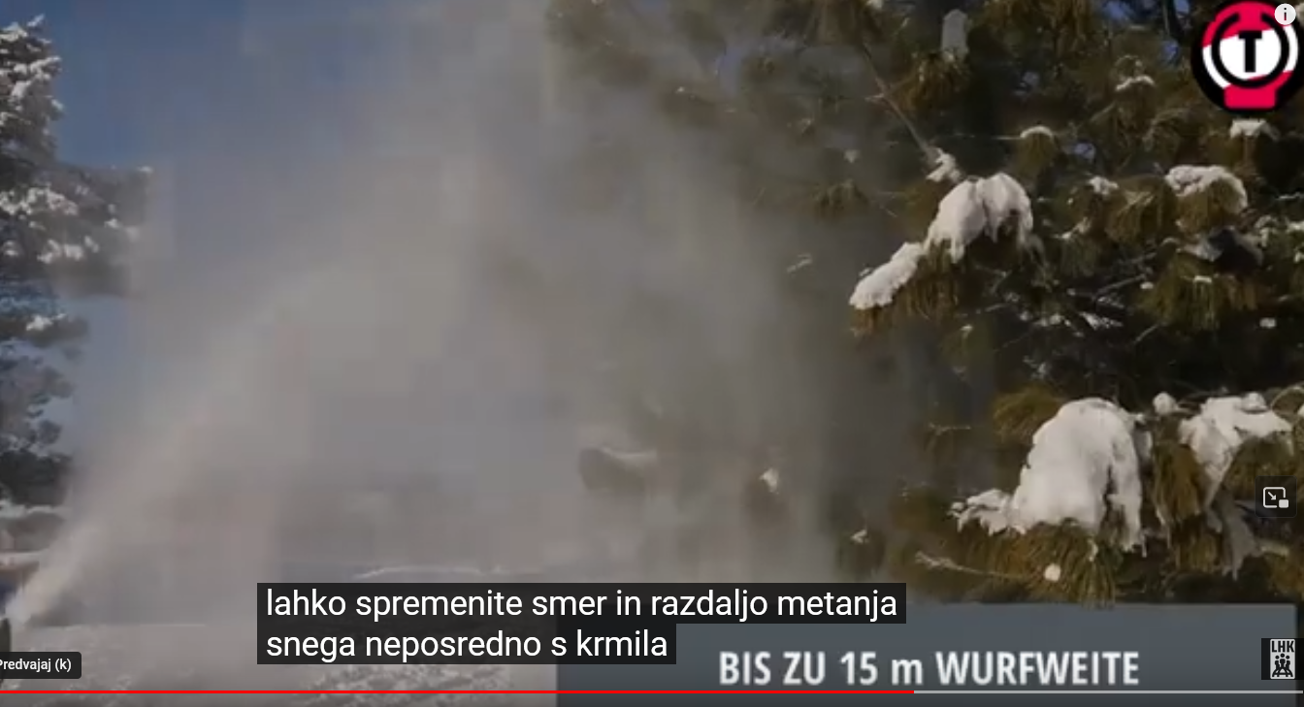

Slide 7
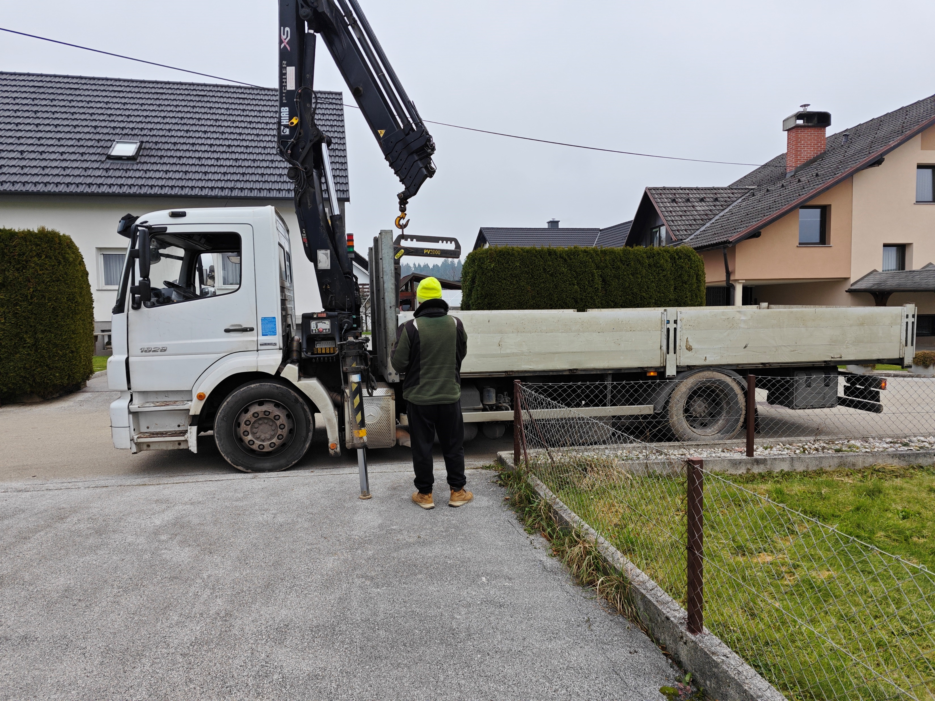

Slide 8
